Slide 1
FAKE BANK CURRENCY DETECTION
Application Development 2 : Machine Learning
PROJECT TEAM MEMBERS:
AJAY 2011CS020006
AKASH 2011CS020007
ANEESH 2011CS020008
HARI 2011CS020009
JATIN 2011CS020010
GUIDED BY
Prof. Veena Rani

Slide 2
ABSTRACT:
After Demonetization , Fake Currency has increased more in the society. This will reduce the country economy and decrease the poverty. To avoid this someone has to monitor the currency whether it is real or forged. It is very difficult for a human to check every currency. So here is an approach to decrease the man power and with the help of these algorithms we can find whether the given currency is fake or real.
The main moto of this project is to find whether the currency is forged or real. For that we have taken datasets such as 500/- , 2000/- currency datasets and train the model.

Slide 3
ANALYSIS OF THE PROJECT:
Create discrepancies of money miscreants introduce the fake notes which resembles to original note in the financial market. During demonetization time it is seen that so much of fake currency is floating in market. In general by a human being it is very difficult to identify forged note from the genuine.
To discriminate between fake bank currency and original note is a challenging task. So, there must be an automated system that will be available in banks or in ATM machines. To design such an automated system there is need to design an efficient algorithm which is able to predict weather the banknote is genuine or forged bank currency as fake notes are designed with high precision. particular train test ratio.

Slide 4
MODULES:
Support Vector Machine (SVM) : Support Vector Machine or SVM is one of the most popular Supervised Learning algorithms, which is used for Classification as well as Regression problems. However, primarily, it is used for Classification problems in Machine Learning.
Random Forest : Random Forest is a popular machine learning algorithm that belongs to the supervised learning technique. It can be used for both Classification and Regression problems in ML. It is based on the concept of ensemble learning, which is a process of combining multiple classifiers to solve a complex problem and to improve the performance of the model.
Decision Tree: Decision Tree is a Supervised learning technique that can be used for both classification and Regression problems, but mostly it is preferred for solving Classification problems. It is a tree-structured classifier, where internal nodes represent the features of a dataset, branches represent the decision rules and each leaf node represents the outcome.

Slide 5

MODULES:
K-Nearest Neighbour: K-NN algorithm stores all the available data and classifies a new data point based on the similarity. This means when new data appears then it can be easily classified into a well suite category by using K- NN algorithm.
Naïve bayes: Naïve Bayes algorithm is a supervised learning algorithm, which is based on Bayes theorem and used for solving classification problems. It is mainly used in text classification that includes a high-dimensional training dataset.

Slide 6
REQUIREMENT:
SOFTWARE REQUIREMENT : During this project, we have used some software tools to perform the tasks of the modules.
• Jupyter Notebook
• PyCharm
• Spyder
HARDWARE REQUIREMENTS : We performed this project based on some hardware requirements to better performance of the project.
• RAM : 4 GB
• ROM : 20 GB
• PROCESSOR : i5
• ARCHITECTURE : 4 Core

Slide 7
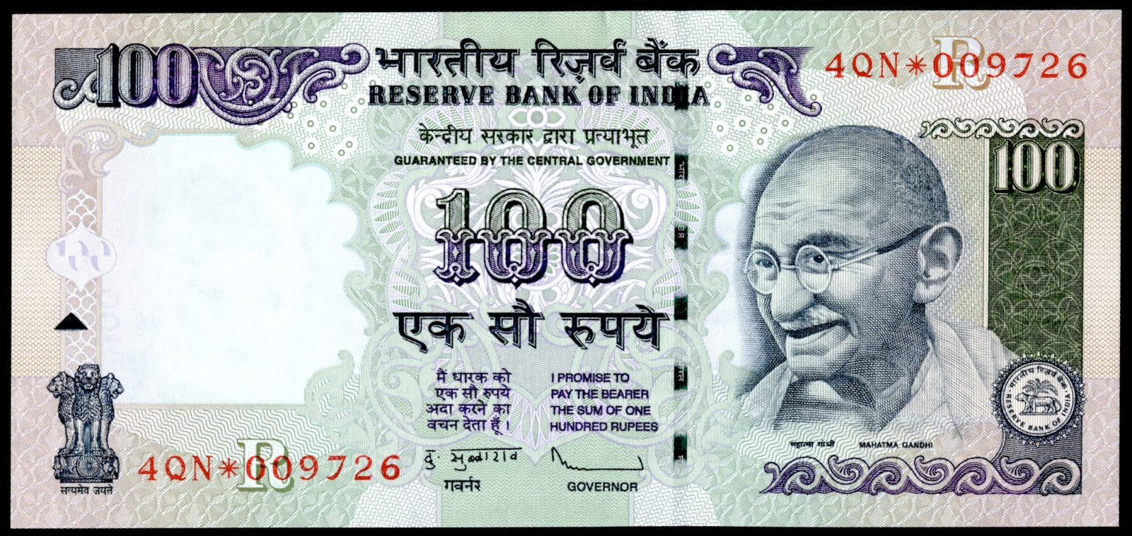
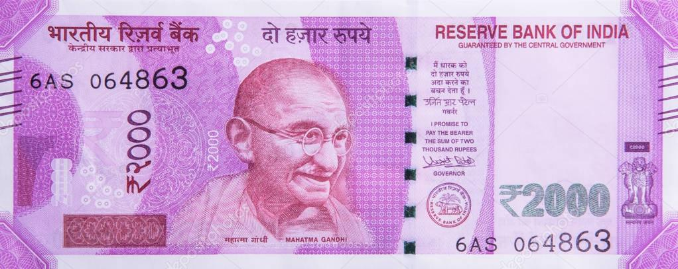
ANALYSIS OF CURRENCY :
We had taken some parameters to analyze the currency such as….
✓ Towards the right side, you will find the signature of RBI Governor Urjit Patel with promise clause and the RBI emblem.
✓ To the left hand side of the Mahatma Gandhi portrait, you will see the number 2000 printed in Devnagari script. ✓ The security thread woven into the note is a multicolor one that carries the words ‘RBI’ and ‘Bharat’ in Devanagari and the numeral ‘2000’ when viewed from different angles. Based on these parameters we will be predicting the currency notes.
100 Rupee Note
2000 Rupee Note

Slide 8
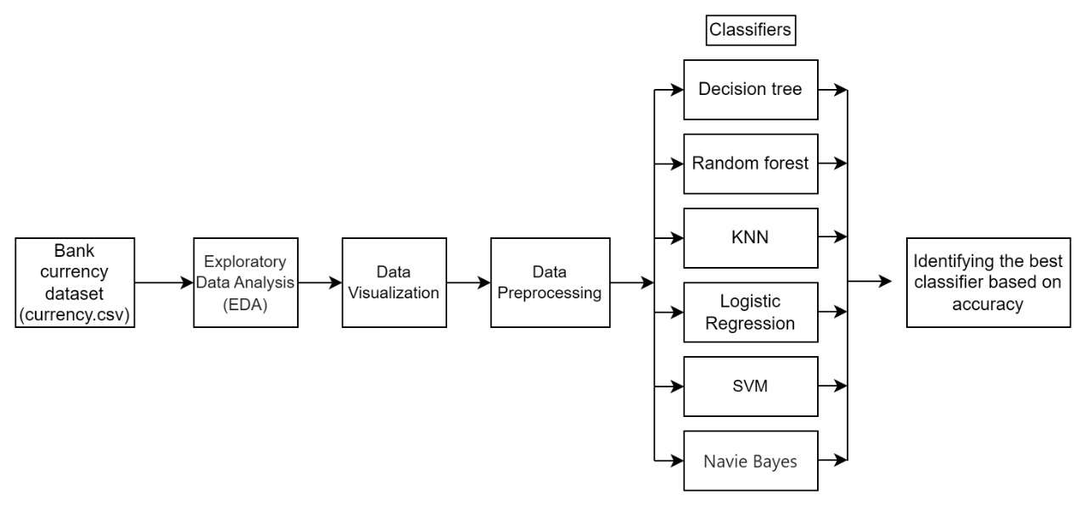
ARCHITECTURE

Slide 9
EXISTING SYSTEM:
PROPOSED SYSTEM:
In existing system, Image processing Is being used with legacy version of machine learning algorithm. Also, they are using local database which reduces the portability of system and because of their system is limited to PC device user friendliness is not good.
In proposed work, we will develop a system that would perfectly assess the features of fake note and real notes based on the paper by Prof. Anju Yadav, Prof.Tarun Jain, Prof. Vivek Kumar Varma, Prof. Vipin Paul. Our proposed system will be capable of performing real time detection of fake currency as we are using SVM, Logistic Regression, Random Forest.

Slide 10

CONCLUSION AND FUTURE SCOPE:
Our System will be helpful for the regular peoples who are technically not involved in daily life with background processes. A smartphone app will provide its user an concise way to perform a very necessary task.
In forthcoming future, we will be able to embed this application in smart phones using OCR(Optical Character Recognition) hence there is no need for a user to go somewhere to verify whether the currency is real or forged.
You can find the project on Github.com/JatinAllamsetty27

